Slide 1
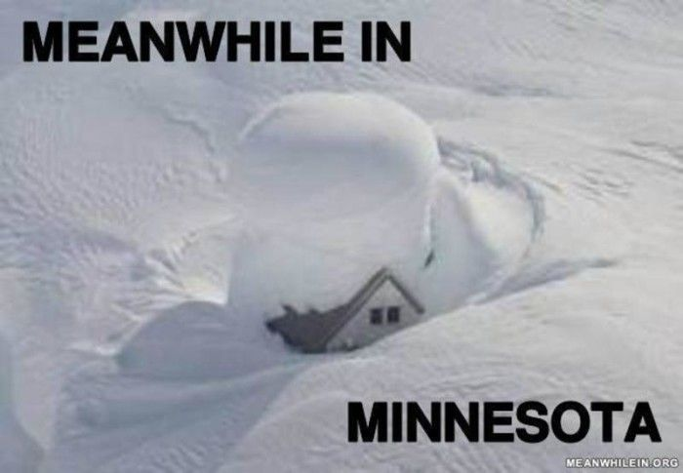
Team 7 Presentation – Has Weather in Minnesota Gotten More Severe?
Notes:
Faduma

Slide 2

Team 7 Presentation – Has Weather in Minnesota Gotten More Severe?
Team Members:
Kristina Langsten, Emily Frels, Faduma Ali, Jeff Brown
Project Description/Outline:
Group 7 will be looking at weather statistics for the state of Minnesota to determine if severe weather is trending upward in the past 70 years. We believe severe weather has increased over the years due to Global Warming and from personal experience.
All of the data in our dataset is considered severe. There are also definitions provided on the NOAA website with numbers corresponding to what is severe, but we will not have to determine this on our end with the data provided.
Hypothesis:
Between 1950 and 2020, on average there has been an increase in the number of severe weather instances.
Null Hypothesis:
The average number of instances of severe weather between 1950 to 2020 has not changed or has no statistical significance.
Research Questions to Answer:
Basic Questions:
Has Minnesota weather gotten more severe over the years since 1950?
Seasonal Temperature Trends
Average yearly temperature
Has number of tornadoes experienced in Minnesota increased?
Has the number of total severe storms in Minnesota increased?
Notes:
Faduma

Slide 3

Team 7 Presentation – Has Weather in Minnesota Gotten More Severe?
Where can we find data?
National Oceanic and Atmospheric Administration (NOAA) have some amazing databases:
Severe Storm Database (ftp://ftp.ncdc.noaa.gov/pub/data/swdi/stormevents/csvfiles/)
Counts of severe storms by State for the US.
Defines and counts 48 different types of storms (did you know Minnesota had an incident of rip currents? Who knew!)
Data from 1950 to present, each year as a separate CSV.
Is source for our Severe Storm Incident Data (like Tornados)
Important note: from 1950-1995 only recorded Tornados, Wind and Hail as severe storms. Starting 1996 recorded all 48 types of severe storms.
NOAA Online Climate Database (https://www.ncdc.noaa.gov/cdo-web/datatools/findstation)
Data as far back as 1853 for select weather stations.
Can find stations by state and then see what is recorded.
Can retrieve Average Temperature and Precipitation Data for Stations. Each station is a unique csv file.
For Minnesota found 7 stations that had good data to work with: ADA, Cloquet, Roseau, Winnibigoshish Dam, Warroad, Hallock, Alexandria Chandler Field, Canby, Collegeville St. John
Notes:
Faduma

Slide 4
What Data Did We Analyze to Test our Hypothesis?
Severe Storms
Number of Tornadoes and Wind/Hail storms per year from 1950 to 2019 (regression)
ANOVA on data – any statistical significance?
Occurrence of different severe storms from 1996 to present (because we can and it is cool to see).
Number of Severe Storm Events per year from 1996 to present (regression).
ANOVA on Severe Storm Events per year from 1996 to present – any statistical significance?
General Weather Severity
Break weather database into seasons – interested in winter and summer (coldest and hottest times).
Look at change in average seasonal temperature in winter and summer (regression) as a function of years.
ANOVA on any statistically significant correlation.
Look at change in average maximum and minimum seasonal temperatures (regression) as a function of years.
Look at seasonal temperature swing (maximum - minimum) in winter and summer (regression) as function of year.
Look at statistical significance of seasonal swing by ANOVA.
Notes:
Faduma

Slide 5
Jupyter Notebook to look at how data was cleaned
Notes:
Emily

Slide 6
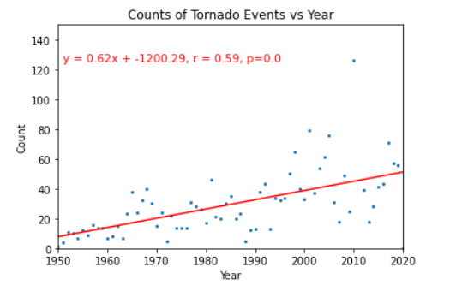
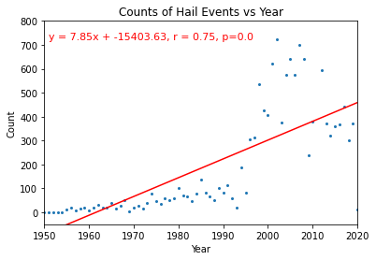
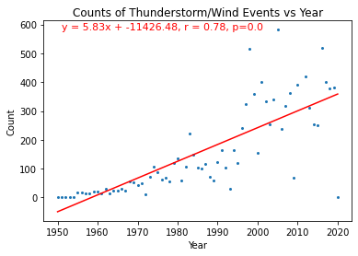
Number of Tornadoes and Wind/Hail storms per year from 1950 to 2019 (regression)
Notes:
Kristina

Slide 7
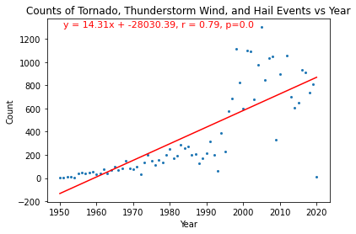
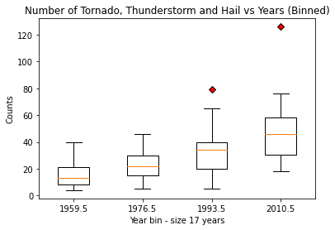
Number of Tornadoes and Wind/Hail storms per year from 1950 to 2019 (regression)
Results:
Hypothesis: Between 1950 and 2020, on average there has been an increase in the number of severe weather instances.
Null Hypothesis: The average number of instances of severe weather between 1950 to 2020 has not changed or has no statistical significance
ANOVA for Binned Data statistic=11.1131, pvalue=5.7817e-06
The p-value is less than 5% so we reject the Null Hypothesis - Events are not independent of years.
Regressions show increasing counts with years. Correlation coefficent r = 0.79, R2 = 0.62 (62% of variation due to linear change with time).
Note: 2020 is not included in the ANOVA test (not complete year)
Therefore, reject the Null Hypothesis - Between 1950 and 2020, on average there has been an increase in the number of severe weather instances
Notes:
Kristina

Slide 8
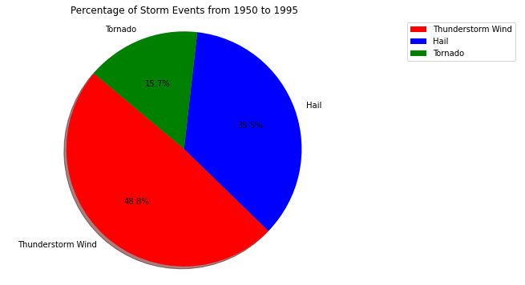
Occurrence of Different Severe Storms pre 1996 to Present (because we can and it is cool to see).
Notes:
Remember, only three storm types tracked before 1996.
Thunderstorm/Wind is dominant storm type, accounting for almost 50%.
Does this seem reasonable?
Notes:
Kristina

Slide 9
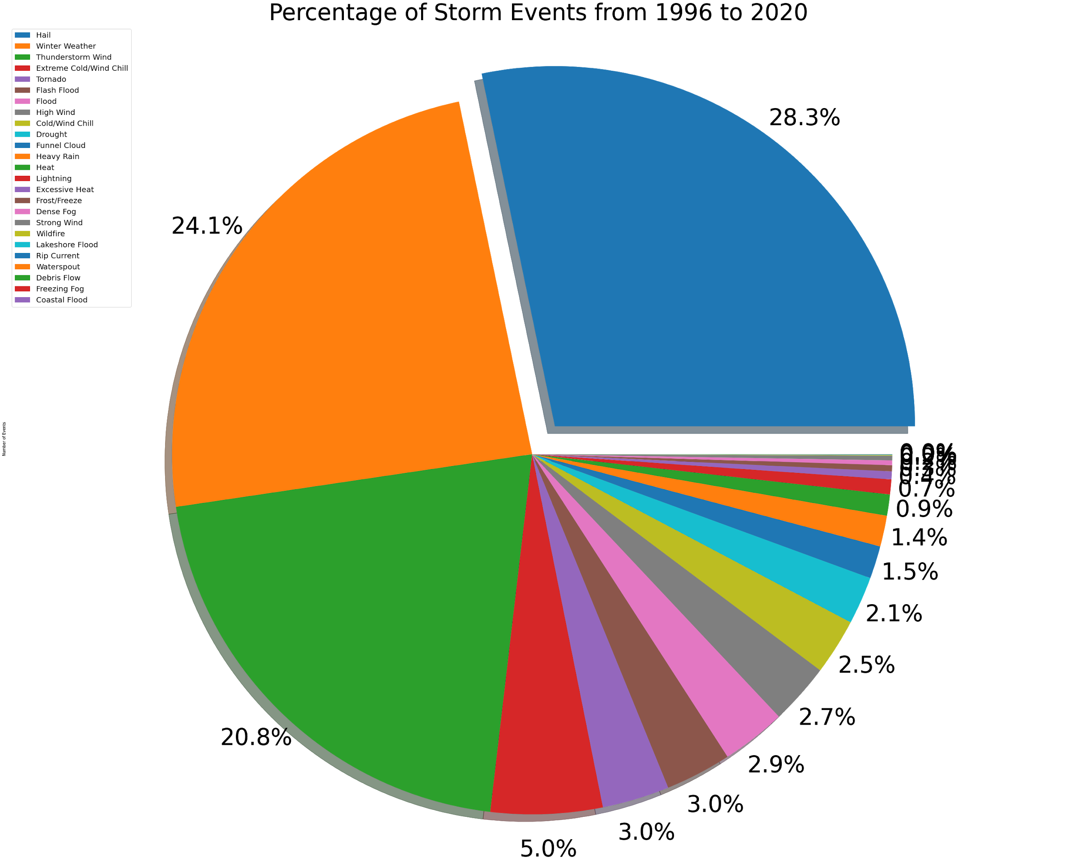
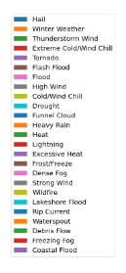
Occurrence of Different Severe Storms pre 1996 to Present (because we can and it is cool to see).
Notes:
Previously Thunderstorm/Wind was nearly half. Now only ~21%.
Winter Weather* accounts for 24%
Unexpected:
Water spout, rip current, coastal flood
Winter Weather (Z). A winter precipitation event that causes a death, injury, or a significant impact to commerce or transportation, but does not meet locally/regionally defined warning criteria. A Winter Weather event could result from one or more winter precipitation types (snow, or blowing/drifting snow, or freezing rain/drizzle).
https://www.ncdc.noaa.gov/stormevents/pd01016005curr.pdf
Notes:
Kristina

Slide 10
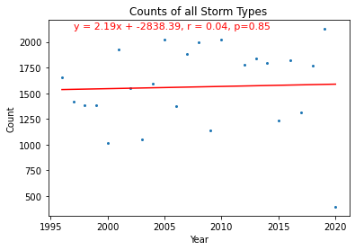
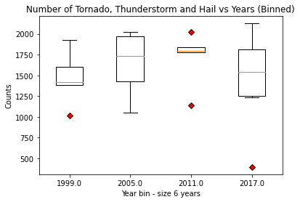
Number of Severe Storm Events per year from 1996 to present (regression).
ANOVA on Severe Storm Events per year from 1996 to present – any statistical significance?
ANOVA:
Test Result statistic=0.570447221781866,
pvalue=0.6409459516617617
The p-value is greater than 5% so we accept the Null Hypothesis - Number of Severe Storm Events per year are not changing in a statistically significant way (for 1996-2020 all Events Counted)
Notes:
Kristina

Slide 11
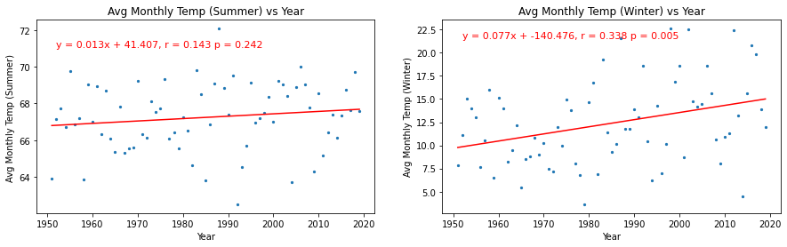
Climate Database
Look at change in average seasonal temperature in winter and summer (regression) as a function of years.
Data is presented in database monthly. Take average of the monthly temperature for seasons (Dec-Feb = Winter, March-May = Spring, June-Aug = Summer, Sept-Nov = Fall). Only interested in Winter and Summer (severe seasons)
The Average Monthly Temperature in Winter is positively correlated with years, the correlation being statistically significant. However the correlation has little predictive power (11% of the variation is account for by the Model).
The Average Monthly Temperature in Summer is not correlated with years, the p value showing no statistically significant relationship.

Slide 12
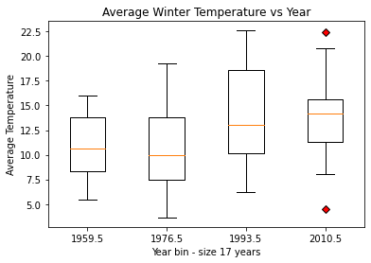
Climate Database
Winter shows a positive, significant correlation with temperature. Is the relationship between average winter temperature and year statistically significant?
Hypothesis: The average winter temperature is dependent upon the year (increasing).
Null Hypothesis: The average winter temperature is independent of the year.
ANOVA
statistic=0.1528
pvalue=0.9278
p>0.05 so accept the Null Hypothesis:
The average temperature is statistically independent of the year from 1950 to 2020.

Slide 13
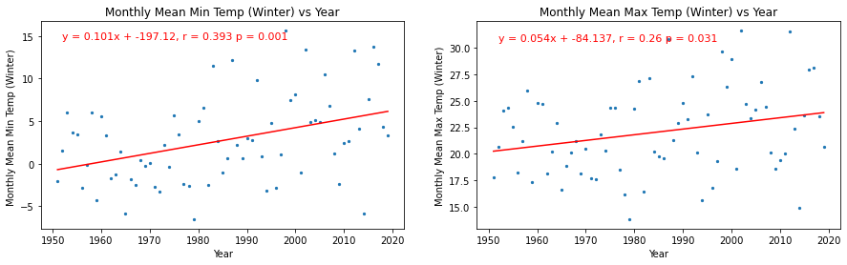
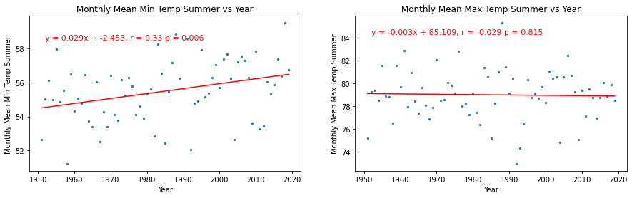
Look at change in average maximum and minimum seasonal temperatures (regression) as a function of years.
Data (max and min temperature) is presented in database monthly. Take average of the monthly temperature for seasons
Calculated slope is not a good indicator of rate of change.
Average Max and Min Temperatures in Winter and Min in Summer have positive correlations with year, but r value indicates low predictive power.
Average Max Temperature in Summer is not correlated to year.

Slide 14
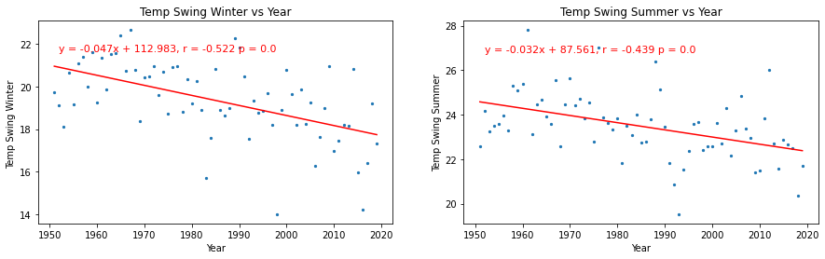
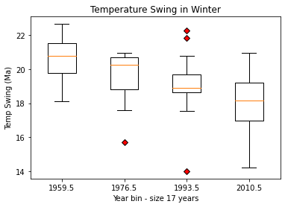
Look at seasonal temperature swing (maximum - minimum) in winter and summer (regression) as function of year. Range of temperatures experienced is a measure of volatility or severity.
Look at statistical significance of seasonal swing by ANOVA.
ANOVA Results
statistic=5.809,
pvalue=0.00073
The p value shows a significant difference exists among the data sets.
The regression analysis shows shows the temperature swings between hottest and coldest points of season are negatively correlated. While significant, it does not show increased severity due to temperature swings (decreasing rather than increasing).

Slide 15
Conclusions:
Severe Weather:
Hypothesis: Between 1950 and 2020, on average there has been an increase in the number of severe weather instances.
Null Hypothesis: The average number of instances of severe weather between 1950 to 2020 has not changed or has no statistical significance
Based on ANOVA test of significance, reject the Null Hypothesis. Therefore between 1950 and 2020, on average there has been an increase in the number of severe weather instances.
Seasonal Temperature:
Average Temperature in Summer and Winter
Regression analysis showed no correlation of average monthly temperature in summer to year. However a correlation was found for the average monthly temperature in winter. The predictive power of this correlation is weak. To check for significance:
Hypothesis: The average winter temperature is dependent upon the year (increasing).
Null Hypothesis: The average winter temperature is independent of the year.
Based on an ANOVA test of significance, accept the Null Hypothesis. Therefore between 1950 and 2020 there is not a statistically significant relationship between year and average monthly temperature.
Recommended Next Steps
Heat map for tornados in MN. Kind of cool to see.
Dig into the differences in hail definition from 1950-1995 versus 1996 -2020.
Look into other states (neighboring for direct comparison and Southern states).
Look into insurance claims for storm damage - expense increased?

